Slide 1

Valuation: Stated preferences
Principles
Contingent Valuation
Design
Case study
Biases
Choice Modelling
Design
Case study

Slide 2
0 Introduction
1 Social choice
2 Externalities and public goods
3 Decision analysis
4 Valuation: Aims and purpose
5 Valuation: Revealed preferences
6 Valuation: Stated preferences
7 Direct regulation
8 Market-based instruments
9 Complications with instruments
10 Growth and the environment
11 Green accounting

Slide 3
Valuation: Stated preferences
Principles
Contingent Valuation
Design
Case study
Biases
Choice Modelling
Design
Case study

Slide 4
Stated Preference (SP) methods
Infer preferences for environmental goods from reports of intended behaviour in hypothetical markets for those goods
Notes:
OK — so that was the theory of how we value stuff.
How do we operationalise this? Do it in practice?
Today, we’re looking at SP.
…
Pretty simple. Simpler than this sounds!
Could also say
Infer preferences for environmental goods
by asking people what they’d pay for them

Slide 5
Two flavours
Contingent Valuation (CV)
Based on direct question(s) concerning WTP/WTA for an environmental good
Choice Modelling / Choice Experiments (CE)
Based on choices between hypothetical goods with varying attributes, including environmental attributes and price
Also popular in transport, and in market research (‘conjoint analysis’)
What would you pay for this good?
Would you pay £X for good A, £Y for good B, or neither?
Notes:
We’ll look at these both in a bit more detail
CV - like the question I asked about preventing the Deepwater Horizon disaster in our first lecture together.

Slide 6
Stated Preferences: many strengths
Total Economic Value
Including use, option and non-use values
Not reliant on any actual market
… nor on such markets being perfect
… nor on the availability of data on such markets
Hence applicable ex-ante — including to novel goods, or novel levels of goods
Can explore reasons behind preferences
Widely used and researched
Comprehensible to policymakers!
Notes:
Explore reasons e.g. Why are people WTP for cleaner air? Cleaning bills? Aesthetics? Health?
Great strengths.

Slide 7
Stated Preferences: real weaknesses
Costly, time-consuming
Not rooted in actual behaviour
Money not where the mouth is
Various potential biases …
Notes:
Requires complex, large scale surveys, much piloting and refinement, etc.
Not actual behaviour — next slide
Biases — later on this lecture

Slide 8


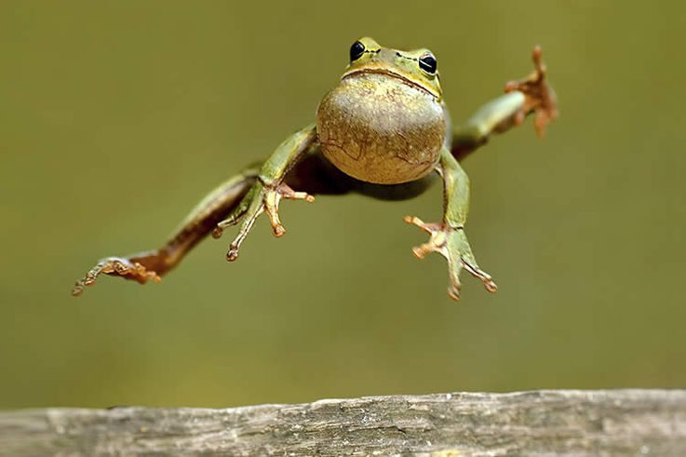
3 leaps from real behaviour: assumes …
actual behaviour in a real market = intended behaviour in a real market = intended behaviour in a hypothetical market = reports of intended behaviour in a hypothetical market
Notes:
SP sometimes controversial, because all 3 of these equalities are open to question…
intention not always action (e.g. me driving to work)
hypothetical market may not be fully described, fully understood, certainly not experienced — I may not be able to fully predict how I’d behave
reports may differ from actual intentions — social desirability bias
…
So there are serious weaknesses. But also serious strengths — ability to get at non-use values especially.

Slide 9

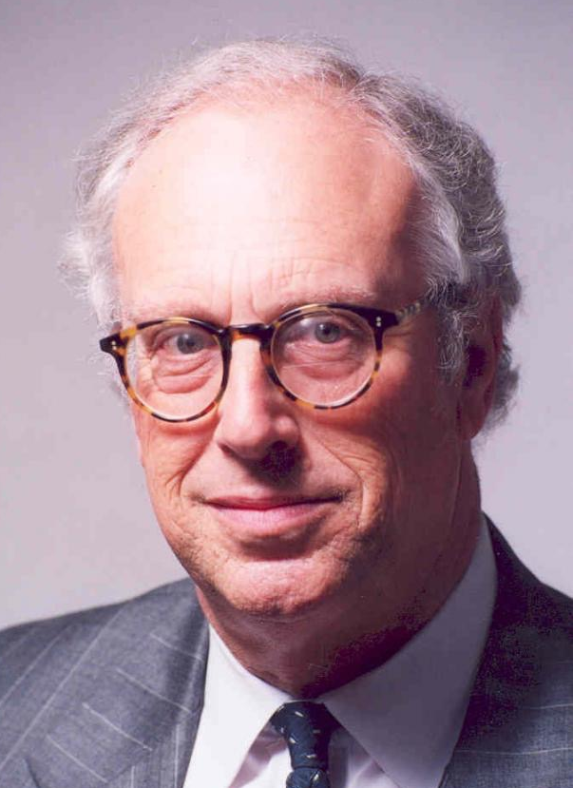
Big stuff
“It is hard to overestimate the central importance of contingent valuation to modern environmental economics” — Carson & Hanemann, 2005
Notes:
Thousands of papers

Slide 10
Valuation: Stated preferences
Principles
Contingent Valuation
Design
Case study
Biases
Choice Modelling
Design
Case study

Slide 11
What would you pay for this good?
Notes:
CV, as I said earlier, is based on answers to questions like this.
Sounds straightforward.
Unfortunately implementation is not as straightforward as it sounds ->

Slide 12

CV: step-by-step
Background research
Survey mode, population & sampling strategy
Survey design (…)
Pre-test: focus groups & cognitive interviews
Re-design
Hire and train interviewers
Field pilot
Re-design
Main survey implementation
Data entry and quality control
Econometric analysis
Validity, reliability testing
Aggregation
Report writing, presentation of results
Evaluation
Notes:
(super brief here)

Slide 13
CV survey content
Use of good
Opinion, satisfaction
Attitudes
General topic
Specific good
Scenario
Current situation
Proposed situation
Elicitation of values
Payment vehicle
Elicitation mechanism
Follow-ups
Motivation, protests
Credibility
Demographics
Age, gender, income, education, family size, …
Notes:
What goes into a CV survey? (lots, but won’t dwell)

Slide 14



Scenario
Clarifies status quo and describes proposed change
Text, figures, photos, maps, video, …
Credible
e.g. Exxon Valdez: double-hulled tankers + escort and emergency-response ships
Meaningful to respondent
Not: “52 MPN faecal coliforms per 100mL”, but:
X
✔
✔
Notes:
How much detail?
People need to know a lot to make an informed judgment.
But people have very short attention spans.

Slide 15
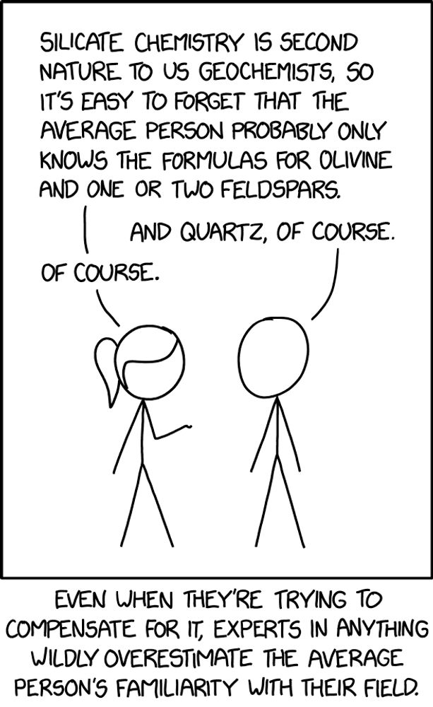

Slide 16
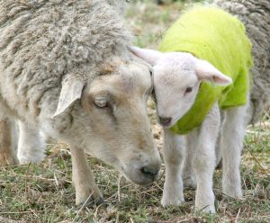
Neutrality & framing
Fluffy little baa-lambs will be senselessly slaughtered
aka minor livestock losses
Notes:
Need to be neutral or objective in your scenario descriptions.
But what’s neutral? Here are 2 ways to describe the same impact. Neither is neutral?

Slide 17
Payment vehicle
Taxes
Bill surcharges
Entrance fee
Parking charge
One-off or recurring?
Not voluntary
For a public good
Notes:
Payment vehicle = the mechanism of payment.
Various possible.
…
WTP can vary by vehicle. Uh-oh.
Note no compensation vehicles here. WTA is almost never assessed.

Slide 18

Some elicitation methods
Open-ended
So: how much are you WTP?
Payment ladder, payment card
Tick the amounts you are certain you are WTP, and cross those you are certain you aren’t
Dichotomous choice (DC), referendum
The policy will cost £X per household. Will you vote for it?
Trichotomous choice
If not, how about £X-Y?
If so, how about £X+Y?
Difficult, unfamiliar, high non-response rates
Easy, incentive-compatible, but inefficient
Notes:
…
Strengths & weaknesses.
Method of analysis depends on elicitation method, as we’ll see later.
WTP may also depend on method. Uh-oh!

Slide 19
Valuation: Stated preferences
Principles
Contingent Valuation
Design
Case study
Biases
Choice Modelling
Design
Case study

Slide 20
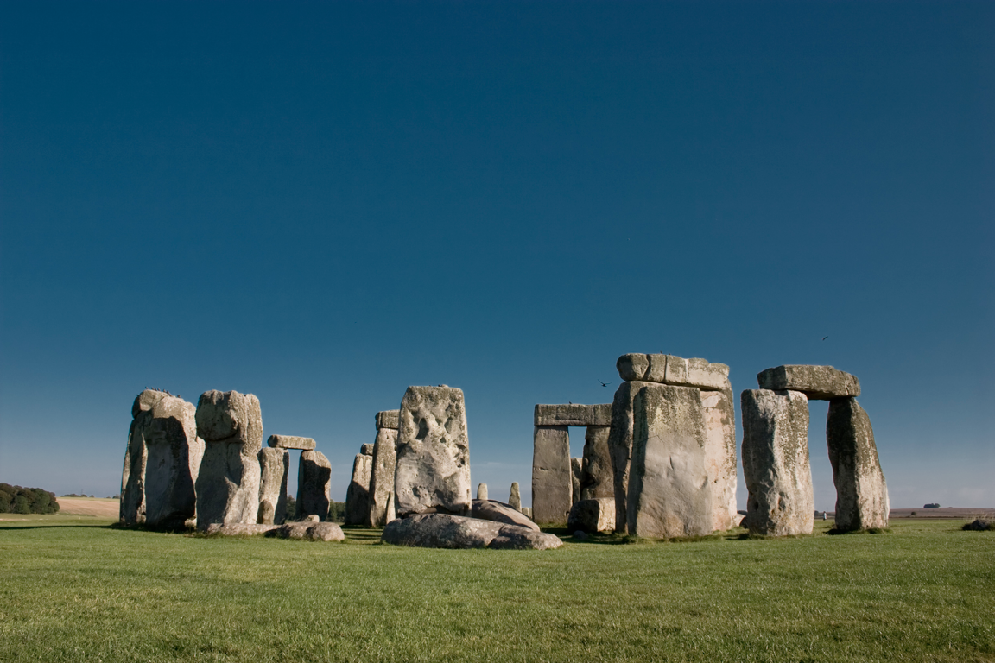
Case study 1: Stonehenge roads
Notes:
[BREAK?]
Stonehenge is one of the best known and archaeologically most important monuments in the world. It was constructed between 5,000 and 3,500 years ago..

Slide 21
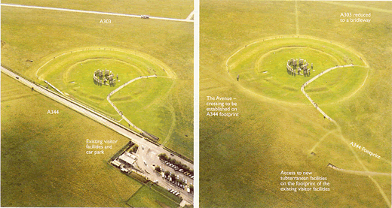
Notes:
Current road layout
Two busy roads near the site — one actually cutting through it.
View of road and roar of traffic are rubbish if you want to enjoy the site. Also rubbish if you’re a druid.
But the view of the monument is nice if you happen to be driving past.
Proposal:
2km tunnel for A303 (busy road to South)
Closure + dismantling of A344 (road to North)

Slide 22
Stonehenge proposal
Costs
£125m construction and maintenance
Loss of visual amenity for drivers
Benefits
Time savings
Lower vehicle operating costs
Fewer accidents
Gain in visual amenity for visitors
Noise reduction
Reunification of the landscape
Notes:
Not clear if this proposal will result in a net gain or a net loss of welfare: hence CBA.
White costs and benefits are the usual factors considered by DfT in a transport project appraisal.
But ignore the main reasons for undertaking the project! I.e. the yellow highlighted costs and benefits, which are the environmental or heritage factors.
English Heritage commissioned an SP study to value these in 1998.

Slide 23
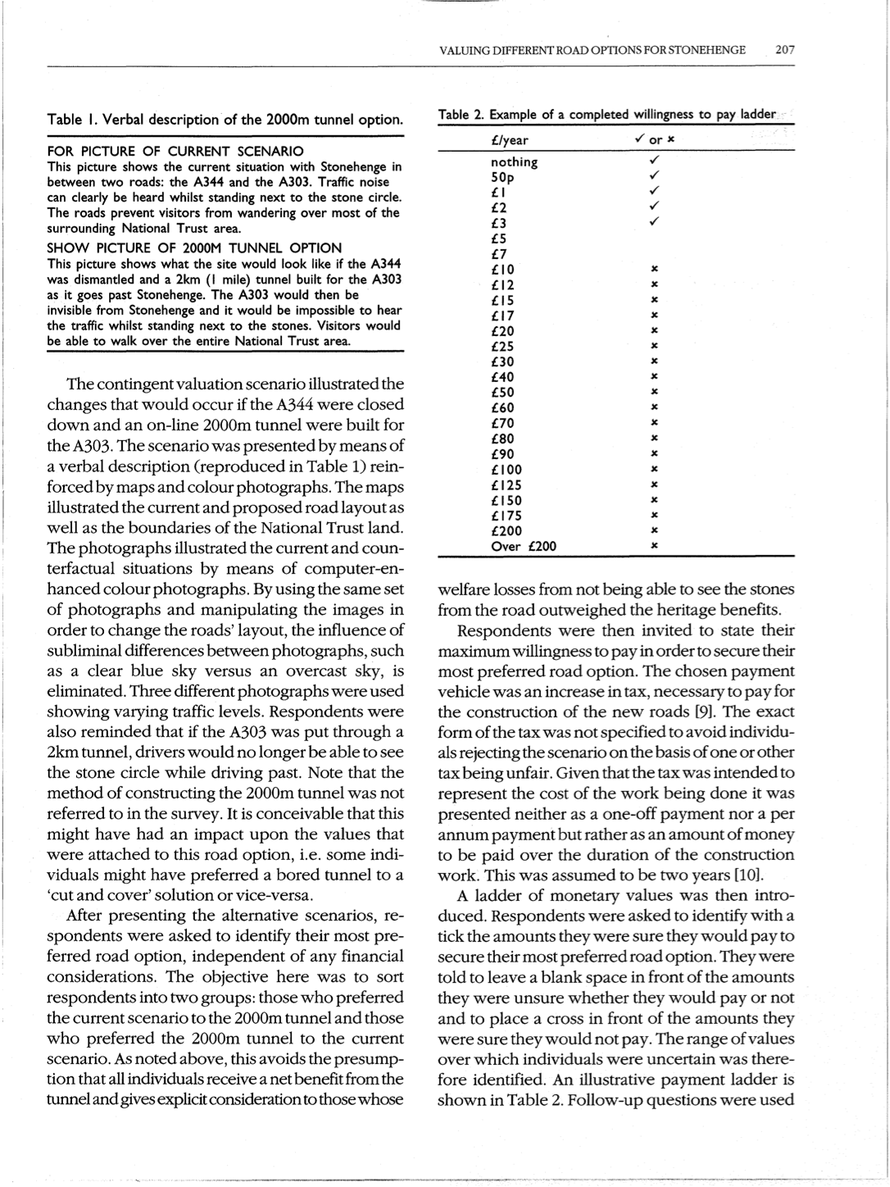
Scenario
Verbal description, maps, images

Slide 24
Value elicitation
Which option preferred?
Status quo or proposed change
Max WTP to secure?
Implies no right to either situation
Vehicle: non-specific tax over 2 years
Format: payment ladder
Notes:
Tick all the amounts you’re sure you would pay
X all the amounts you’re sure you wouldn’t
Note: people told to consider only the benefits described: not any safety or journey time benefits — otherwise those would be double counted.

Slide 25
Follow-up questions
My household cannot afford to pay
I like the current situation
I think this problem is not a priority
The government should pay for this
Taxes are high enough as it is
Notes:
Which are protests? (last 2)

Slide 26
Preferences and WTP (re-weighted)
55% prefer status quo
Mean WTP: £2.69/year
Dropped protests about paying for nothing to be done
Main motivations: miss view from road, and dislike driving in tunnels
45% prefer tunnel
Mean WTP: £8.90/year
Main motivation: secure landmark for future generations
£££
£££££££££
Notes:
Outcome?
Weighted to approximate whole of UK
Yearly values, over two years of construction only
Two ways to see this!
1. valuation allows us to assess strength of preference and come to a better decision than a simple poll does
2. valuation is profoundly anti-democratic, and lets a wealthy minority dictate policy for the rest of us

Slide 27
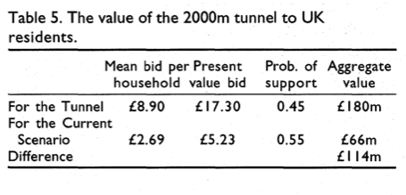
Aggregation
Notes:
col 2: present value over 2 years at 6% discount rate (??)
Pushes CBA to net benefit: worth doing. Govt announced would be built.
But still not done. Disputes over bored vs cut-and-cover tunnel. Plans abandoned.

Slide 28
Valuation: Stated preferences
Principles
Contingent Valuation
Design
Case study
Biases
Choice Modelling
Design
Case study

Slide 29
How robust are CV results?
Face validity – does it make sense
Construct validity – does it measure what it intends to measure
Content validity – does it measure all of it, or perhaps more
Criterion validity – accuracy, or best practice
Convergent validity – related measures correlate
Divergent validity – unrelated measures do not
Compatibility with theory
Test-retest reliability
Notes:
Face validity = look at study design and exercise common sense. Correct, credible scenario; not too many protests or non-responses; representative; sensitivity to outliers; etc.
Criterion = compared to some gold standard, such as actual market prices. Generally not available, which is why we’re doing CV.
Convergent = other valuation method (RP, SWB). CV results on average lower than RP (odd, given TEV + other concerns).
Theory: e.g. price coeff negative, WTP falls with distance, increases with income and qty of good, etc.
Test-retest reliability: few studies check, generally OK, but not always.

Slide 30
Hypothetical (non-commitment) bias
Most persistent criticism of CV
No real economic commitment (no skin in the game)
‘Ask hypothetical question, get a hypothetical answer’
Notes:
Not going to have to pay, so don’t think same way: no budget constraint, and no substitute considerations.

Slide 31
Possible solutions
Give respondents time to think
CV interview split in two: one day the respondent is shown the scenario and valuation question; another day he is asked for his response
Time to discuss value with household members, consider budget constraint and substitutes, avoid yea-saying
Drop-off protocol
Interviewer drops off survey and picks it up at a later stage
Recalibrate SP results with data from real experiments
‘Cheap talk’ scripts …
Notes:
Also: compare with other valuation techniques
Cheap talk: imagine this were a real situation and think hard about your budget; don’t just say you’d pay to make you feel good about yourself.

Slide 32
Cheap talk
“Studies have shown that people answering surveys such as this often say that they are willing to pay more than they would if the situation was real and this amount of money actually had to be handed over.
What our ‘yes’ vote really means is that we are basically good people, and that we would like to see good things happen!
But when the situation is real, and we would actually have to spend our money, we think in a different way. We basically still would like to see good things happen, but when we are faced with the possibility of having to spend money, we think about our options: If I spend money on this, that’s money I don’t have to spend on other things.
So while answering this next question please think as if the situation we described were real and you would actually have to pay the amount of money stated.”

Slide 33
Other biases & anomalies
Protests
WTP/WTA disparity
Strategic bias
Use dichotomous choice
Part-whole bias, embedding, scope insensitivity
Due to ‘warm glow’?
Just-noticeable differences?
Temporal embedding
Sequence effects, ‘adding-up’ problem
Starting-point bias, anchoring
Interviewer bias
Yea-saying, nay-saying
Prominence bias
Information bias
Non-response bias
Notes:
[1 slide, but important!]
Protests: identify & exclude (if not too numerous). E.g. don’t believe scenario. E.g. Nature not for sale.
WTP/WTA disparity — mentioned earlier.
Strategic bias: stated WTP to be used to set own tax liability! DC theoretically immune. Not clear that respondents know this, though!
Part-whole: e.g save a species vs save all species. 100ha vs 500ha of wetland. Temporal: annual WTP = one-off.
Information: e.g. don’t know enough about ecosystem functions. e.g. WTP to save 1T carbon!
(Paul Dolan at Treasury: tell me what value you have in mind and I’ll do you a stated preference study to come up with it.)

Slide 34
Controversies: general remarks
Skepticism important in application, use, interpretation of CV
Careful survey design can overcome many issues — but not simple, and may be expensive
CV remains an essential tool for environmental economists, particularly where non-use values are important

Slide 35
Valuation: Stated preferences
Principles
Contingent Valuation
Design
Case study
Biases
Choice Modelling
Design
Case study

Slide 36
Discrete alternatives
Assume value of a good is a function of characteristics
Ask for choices between alternative options
Options vary in characteristics — including price
Choices involve trade-offs
WTP is inferred from choices made
Notes:
1 -- like hedonic pricing studies

Slide 37
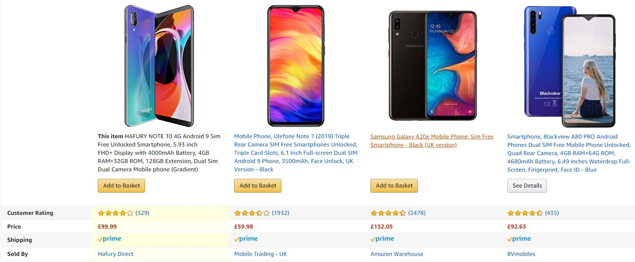
Notes:
This is a market research CE.
Mimics the sort of market situation that’s supposed to make us familiar with CEs.

Slide 38
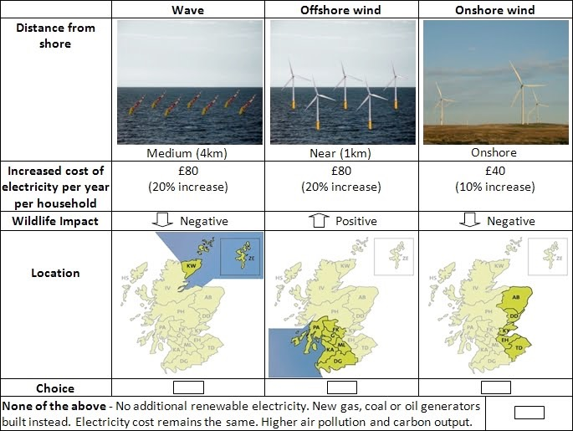
Notes:
Environmental example, 4 options. Which would you choose? 30s to decide.
…
Wave (hands up) … etc …

Slide 39
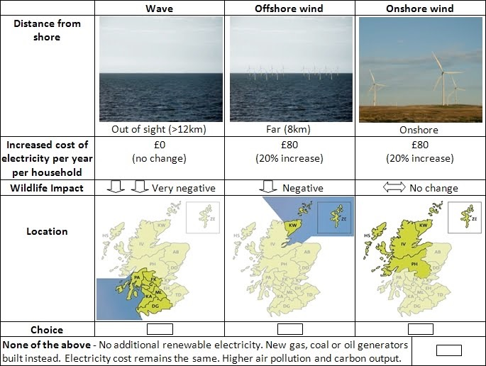
Notes:
Attributes vary between cards. In this study, 6 cards per respondent.

Slide 40
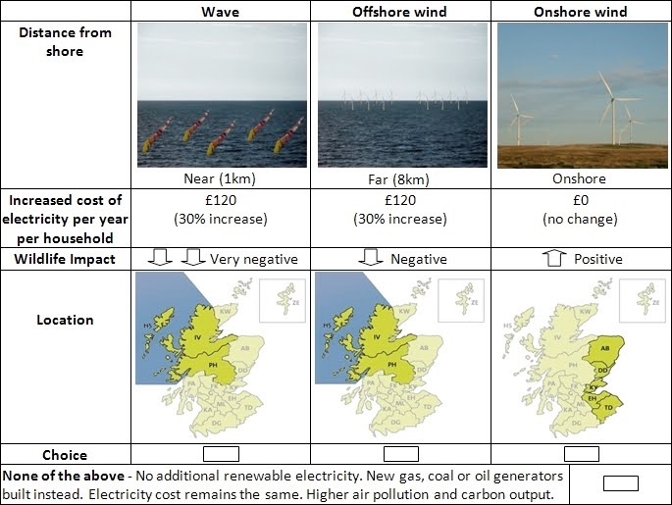
Attributes
Options or alternatives
Labels
Price attribute
Levels
Status-quo option
electricitysurvey.com
Notes:
Terminology
Each choice set is presented on a choice card.
On each card, you have several options which vary in the levels of attributes
For compatibility with welfare theory, a status quo option must be available: nothing done, no cost.
Some attributes may have a prior expectation on whether +ve/-ve (e.g. price, wildlife). Others may not (e.g. location).
From a study carried out by a PhD student at Stirling.

Slide 42
Choice modelling: better than CV?
WTP for attributes
Multidimensional change
Infer WTP for projects nobody was asked about — by combining attributes post-hoc
Diffuse cost focus
WTP is implicit
Fewer protests
More familiar, more like market choices
Less yea-saying, nay-saying

Slide 43
Choice modelling: worse than CV?
Cognitive burden for respondents
Satisficing, heuristics (e.g. look at one attribute only)
Technical complexity for researchers
Design + analysis
Notes:
one attribute — e.g. ‘the environmentally friendly choice’ or the cheapest
Didn’t I just say it was easier because more familiar?!
If difficult, generally researchers’ fault! Getting greedy and asking about too many attributes and/or presenting too many cards.

Slide 44
Choice experiments: step-by-step
Same as CV, plus:
What attributes?
What levels?
Construct choice sets
Analysis
Random Utility Model — same as for travel cost

Slide 45
Valuation: Stated preferences
Principles
Contingent Valuation
Design
Case study
Biases
Choice Modelling
Design
Case study

Slide 46

Case study 2:
carbon offsets

Slide 47
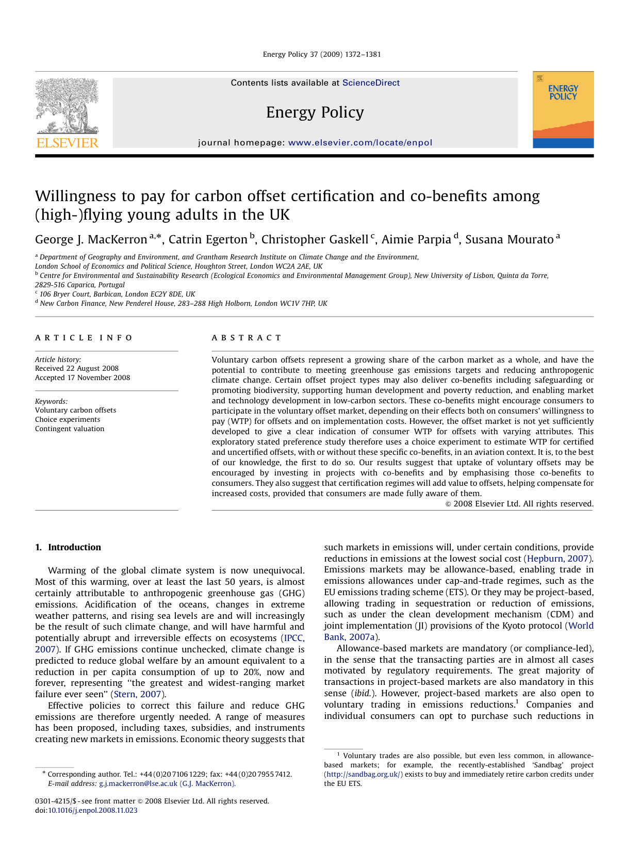
Notes:
A study of mine, plus colleagues, published in Energy Policy.
Not a classic study in env econ — actually more like a market research study. Because although carbon reductions are a public good, offsets are sold in private transactions to consumers.
Looking at impacts of co-benefits and certification on consumers’ WTP for carbon offsets when flying.
Actually in two parts…

Slide 48
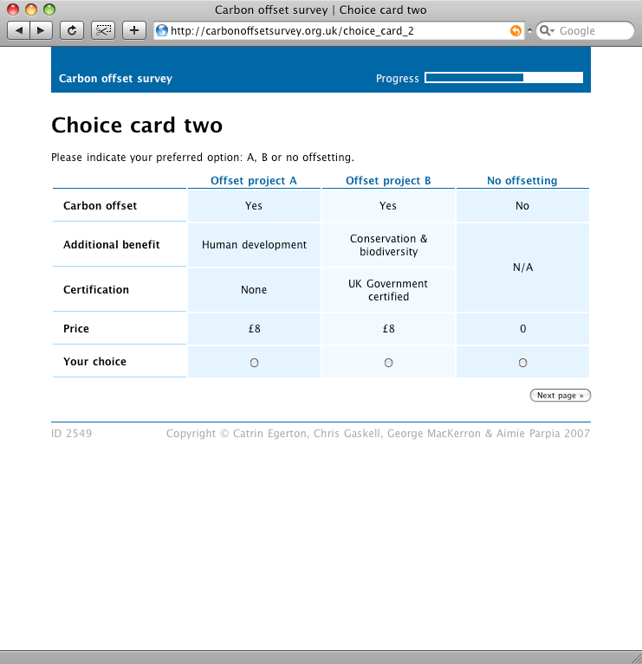
Choice experiment
Conservation & biodiversity
Human development
Market & technology development
None
Notes:
CE consisted of 6 cards like this one.
To estimate WTP for offsets and co-benefits, and certification.
Levels:
Co-benefits: one of the 3 mentioned earlier, or none — these explained to respondents in more detail
Certification: yes or no
Price: same levels as on last slide, £4 - £20

Slide 49
CE results (RPL)
 | Coefficient (std. err.) | Implicit price (95% CI)
ASC (offset) | 3.106 (0.691) | £12.47 (£7.41 – £17.52)
Std. dev. | 5.976 (0.635)
Certification | 2.776 (0.278) | £11.14 (£9.31 – £12.98)
Std. dev. | 2.553 (0.302)
Price | –0.249 (0.021) | –
Std. dev. | Fixed coefficient
Human development | 3.201 (0.358) | £12.84 (£10.41 – £15.28)
Std. dev. | 2.089 (0.361)
Biodiversity | 3.734 (0.356) | £14.98 (£12.67 – £17.30)
Std. dev. | 1.891 (0.381)
Tech./mkt. development | 2.631 (0.284) | £10.56 (£8.62 – £12.50)
Std. dev. | 2.072 (0.313)
p < 0.1% for all parameters
Notes:
V high std dev on offset WTP …

Slide 50
Heterogeneity in tastes…
“
it's an emergency, we must act!
if I don't do my bit, I can't blame others for not doing theirs when the ice cap melts
WE MUST FIGHT FOR THE PENGUINS!!!
this sounds like a scam
it’s bourgeois and distracting to do the whole offset thing
let's all fly more to do more good, right? You disgust me.
”
Notes:
… which we also saw in the text comments left by over one third of our respondents.
On the one hand…
… and on the other …

Slide 51
Measures of value
Maximum willingness to pay (WTP)
How much I value something I do not have is measured by the most that I will give up in order to gain it
Hicksian equivalent variation
Minimum willingness to accept (WTA)
How much I value something I do have is measured by the least I must gain in order to give it up
Hicksian compensating variation
Notes:
That gives us two key measures of value:
First, …

Slide 52
Expenditure on private goods y
y0
WTP
u0
e0
e1
Quantity of environmental good e
Maximum WTP to secure improvement
Notes:
For example.
Let’s say an individual starts out with an income of y0, and enjoys environmental quality of e0.
This puts her on the indifference curve u0. Any combination of y and e along this line provides her with equal utility.
Now let’s say we want to know the value to her of an improvement in the environmental good up to e1. With more of the environmental good, she needs less of the private goods to maintain the same level of utility u0.
And so her maximum WTP is this distance between the dotted lines. If she can obtain e1 for any less than this amount, then she’ll end up better off than she was before. If the cost of obtaining e1 is more than this amount, then she would choose not to pay, if given the choice.
This is max WTP for improvement.

Slide 53
Expenditure on private goods y
WTA
y0
u1
e0
e1
Quantity of environmental good e
Minimum WTA to tolerate deterioration
Notes:
But what if the environmental change is a deterioration rather than an improvement? Then things are a little different.
Imagine the individual starts at e1, with the same income y0. She’s therefore on a higher indifference curve than before.
Now we want to know what amount of compensation the individual would need in order to accept a deterioration, down to e0. We again trace up and across from the indifference curve, and find this amount as the minimum WTA.

Slide 54
Four welfare measures
Maximum willingness to pay for an improvement
Minimum willingness to accept for a deterioration
Maximum willingness to pay to prevent a deterioration
Minimum willingness to accept for foregoing an improvement
Notes:
That gives us two key measures of value:
First, …

Slide 55
Expenditure on private goods y
y0
WTP
u0
e0
e1
Quantity of environmental good e
Maximum WTP to avoid deterioration
Notes:
We can show the equivalent surplus measures with essentially the same diagrams as before.
Max WTP to …
This is the same diagram as for WTP to secure an improvement — but instead of paying to move from e0 to e1, we’re paying to avoid moving from e1 to e0.

Slide 56
Expenditure on private goods y
WTA
y0
u1
e0
e1
Quantity of environmental good e
Minimum WTA to forgo improvement
Notes:
Likewise with WTA.
Instead of being compensated for the move from e1 to e0, the individual is being compensated to forgo the move from e0 to e1.

Slide 57
Expenditure on private goods y
WTP ≠ WTA
WTA
y0
WTP
u1
u0
e1
e0
Quantity of environmental good e
Notes:
Here I’ve put all the diagrams together.
What do we notice about WTP and WTA?
WTP and WTA for the same change are not the same.
WTA is somewhat higher than WTP.

Slide 58
WTP ≠ WTA: why the disparity?
Income effect
Substitution effect
Hanemann, 1991
Endowment effect, loss aversion
Behavioural economic explanation
Notes:
1. Income effect. Assume there’s substantial income elasticity of demand for the environmental good — i.e. people will pay a lot more for it as they get richer. Now if you compensate me by the amount I was WTP, I’m richer… and thus WTP more than you just gave me!
Income effect can’t sensibly be very large — and hence until the 1990s it was generally thought that WTP and WTA were more or less interchangeable.
2. Substitution effect. The disparity between WTP and WTA depends on the availability of private substitutes for the environmental good.
Take clean water as an example. If I have a private well or borehole, as people in rural areas sometimes do, and the groundwater on my property gets contaminated, then I can substitute my previously clean water with a private good, in the form of bottled water. (This may or may not be a perfect substitute …).
If perfect substitutes are available, then WTP = WTA. (I take the money I receive in compensation, and use it to buy a perfect substitute).
At the other extreme, if there are no substitutes at all then WTP and WTA could be very different. Say the environmental change is a massive and fatal escape of ionising radiation. For an individual, there are basically no good substitutes for one’s own life. So WTP will be more or less everything one has. But that’s finite: between a few thousand and a few million pounds, maybe (depending on wealth and overdraft limit). WTA, by contrast, will be essentially infinite (i.e. there’s no amount of money you’ll be prepared to accept).
Also, endowment effect (plug for next term!)

Slide 59
Thaler, 1982
By attending class today, you have been exposed to a rare, fatal disease. The probability that you have the disease is one in a thousand. If you have the disease you will die a quick and painless death in one week. There is a cure for the disease that always works, but it has to be taken now. We do not know how much it will cost. You must say now the most you would be willing to pay for this cure. If the cure ends up costing more you won’t get it. If it costs less, you will pay the stated price, not the maximum you stated. How much will you pay?
We are conducting experiments on the same disease for which we need subjects. A subject will just have to expose him or herself to the disease and risk a one-in-a-thousand chance of death. What is the minimum fee you would accept to become such a subject?
Notes:
On that WTP vs WTP disparity, Richard Thaler has a nice in-class experiment.
…
Your values?
In first case: $800. In second: $100,000.

Slide 60
Property rights
Crucial to policy
Your right to pollute, or my right to clean air?
Crucial to valuation
Philosophical, political, legal
Notes:
The question of property rights, and thus of which of WTP and WTA is the appropriate measure, is thus rather important. (Application of what we talked about in lecture 2).
Most studies use WTP, even where WTA is more appropriate. Since we’re normally looking at environmental deterioration, this would be expected to bias CBAs in the direction of too much deterioration.
(For example, when I run HS2 through your garden, or when I build an incinerator in Newhaven, am I going to compensate you?)

Slide 61
Aggregate WTP and WTA
Mean
Mean × population size = total social welfare change
Assumes we don’t care who benefits
If we do, use weights (e.g. income) Also: distance
Median
Referendum: value at which half the population should vote each way
More robust to outliers
Notes:
How do we aggregate WTP and WTA values up to whole regions, or countries, or the whole world? This is what policymakers tend to want to do — they’re going to spend public money on something, they need a measure of the total benefits.
Two ways: …
NB. Multiplication assumes homogeneous values. Often more appropriate to model WTP as a function of income, distance to site, etc. and then aggregate up predicted values from this regression model.

Slide 62
Standing
Whose values count? Whose values are you counting?
e.g. foreigners, foetuses, future generations, criminals
Distance decay
Notes:
A couple of issues that apply to all the methods.
First: standing (accounting stance). As discussed re CBA. Whose values are you interested in? And are you making sure that they’re all represented in your valuation exercise?
e.g. in Exxon Valdez study — excluded Spanish speakers (cost reasons). Spanish speakers may not have been too happy about that.
e.g. if you were calculating the social costs of burglary — do you count the gains to the burglar?
e.g. abortion — foetus?
e.g. if you’re looking at impacts of climate change. Do you deal with values that will be held by future generations?
e.g. if you’re looking at value of a local site e.g. nature reserve. How far away do you assume that people will hold values for this? Tiny values x 7 billion = big values.

